Slide 1
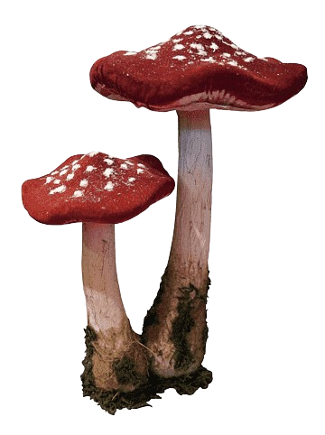
Mushroom Classification Project

Slide 2
Title: Mushroom Classification Project Using Machine Learning Subtitle: A Data Science Project By: Akshay Shekade Date: 08/10/2024

Slide 3
Goal:
The primary goal of this project is to develop a machine learning model that can accurately classify mushrooms as either edible or poisonous, thereby ensuring the safety of individuals engaging in mushrooms foraging.
Importance:
Accurate classification of mushrooms is critical, as consuming poisonous mushrooms can lead to severe health issues or even death. A reliable model can help foragers make informed decisions.
Overview of Methods Used:
The project utilizes various machine learning algorithms, including Logistic Regression, Random Forest Classifier, Gradient Boosting Classifier and Support Vector Classifier (SVC).

Slide 4
Dataset Description
Size of the dataset:
The dataset contains 61070 samples and 21 features that describes various attributes of the mushrooms.
Key Features:
Cap shape (e.g., bell, conical, convex, flat, Spherical)
Cap surface (e.g., Grooves, scaly, smooth, shiny, leathery)
Cap colour
Gill attachment and spacing
Stem height and width
Veil type and colour
Habitat

Slide 5
Data Cleaning Process
Handling Missing Values:
To ensure data integrity and maximize the effectiveness of our analysis, I addressed missing values by categorizing them as ‘unknown’ and removing columns which has too many missing entries.
Data Transformation:
Categorical variables were encoded using Label Encoding to convert them into numerical format suitable for machine learning algorithms.
Removing Outliers:
Outliers were detected and removed using Log Transformation to ensure that they do not skew the results of the classification models.

Slide 6
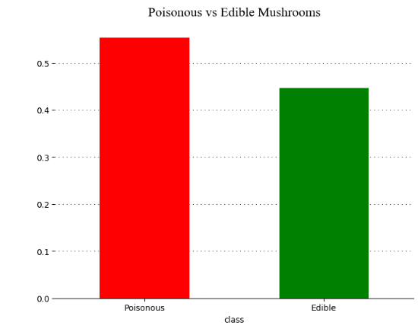
Exploratory Data Analysis (EDA)
The distribution of edible vs. poisonous mushrooms was relatively balanced in the dataset.
In the dataset, 55.4% are Poisonous Mushrooms and 44.6% are Edible Mushrooms.
This is our target variable, and it has 0 missing values.

Slide 7
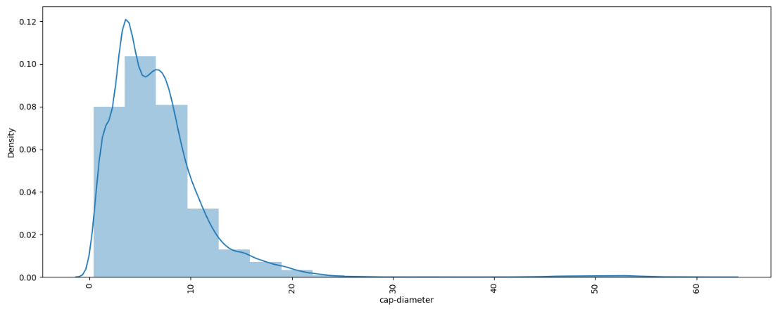
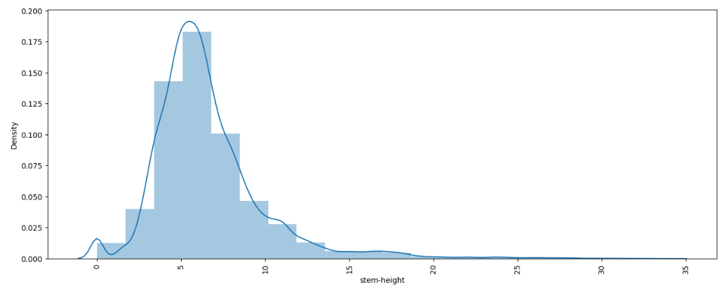
Distplot were plotted to visualize the distribution of numerical features.
The distribution of the cap diameter appears to the right skewed, meaning most of the mushrooms have a smaller cap diameter, but a few have significantly larger cap diameters.
The distribution of stem height is also right skewed, similar to cap diameter. Most mushrooms have a stem height within a relatively narrow range, but there are some mushrooms with unusually tall stems (outliers).

Slide 8
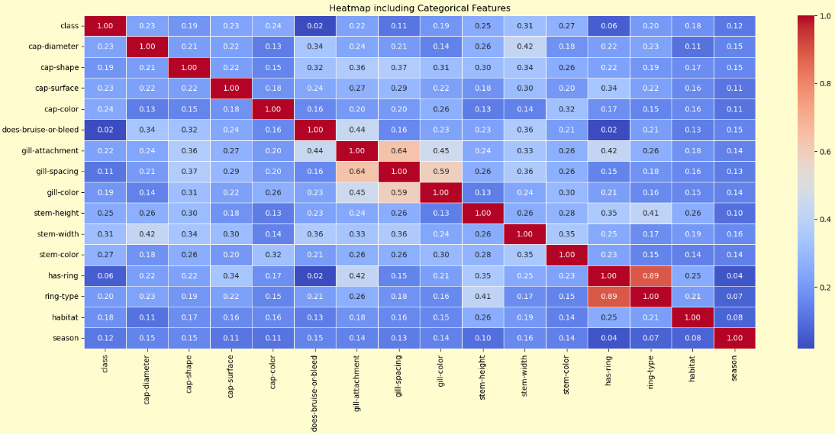
Many features show moderate correlations (0.3 - 0.5) with each other. This suggests complex relationships between mushroom characteristics.

Slide 9
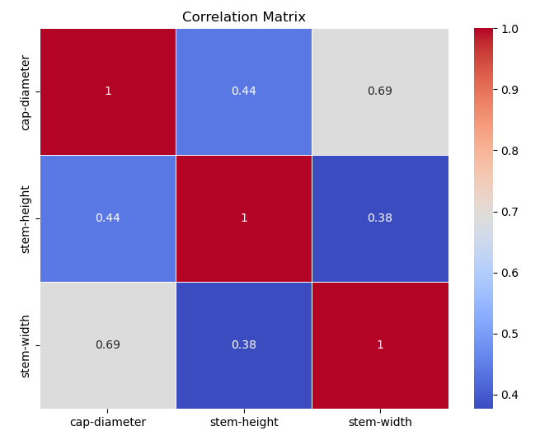
Strongest correlation:
Cap-diameter and stem-width (0.69)
Moderate correlations:
Cap-diameter and stem-height (0.44)
Stem-height and stem-width (0.38)
The matrix suggests that as cap diameter increases, stem width tends to increase more notably that stem height.
The relationship between stem height and width is the weakest among the three variables.

Slide 10
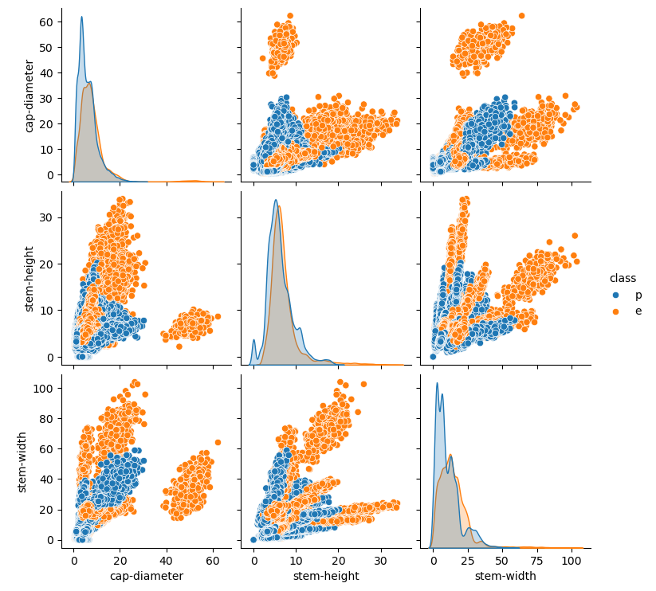
Clear separation between poisonous and edible mushrooms, especially in cap-diameter and stem-height.
Poisonous mushrooms have larger cap diameters and shorter stem heights.
More overlap between classes in stem-width.

Slide 11
Model Selection
Algorithms Used:
Logistic Regression:
Simple and interpretable, suitable for binary classification.
Random Forest:
An ensemble method that improves accuracy by combining multiple decision trees.
Gradient Boosting:
A boosting technique that builds models sequentially to correct errors.
Support Vector Classifier (SVC):
Effective for high-dimensional spaces, especially useful for classification tasks.
Rationale for Choosing These Algorithms:
These models were chosen based on their effectiveness in handling classification tasks and their ability to deal with the specific characteristics of the mushroom dataset.

Slide 12
Model Performance Evaluation
Performance Metrics:
Models were evaluated based on accuracy and ROC AUC scores.
Accuracy measures the proportion of correct predictions, while ROC AUC provides insight into the model's ability to distinguish between classes across different thresholds.
Comparison of Models:
A comparison table was created showing the accuracy and ROC AUC for each model, helping identify the best-performing algorithm.

Slide 13
ROC AUC Curves
Visual Representation:
ROC curves were plotted for each classifier, illustrating the trade-off between the True Positive Rate (TPR) and False Positive Rate (FPR).
Analysis of Model Performance:
Models with higher AUC scores are preferred, indicating better discrimination capability. For instance, a model with an AUC of 0.85 or higher can be considered reliable.

Slide 14
Conclusion
Summary of Findings:
The Random Forest model emerged as the best performer with an AUC score of 1.0, demonstrating strong classification ability.
Importance of Model:
The classification model can be a valuable tool for mushroom foragers, aiding in safe consumption decisions.
Future Work Suggestions:
Future improvements may include gathering more data, further feature engineering, or exploring advanced models like neural networks.

Slide 15

Questions ?

